Slide 1

Risk Based Authentication

Slide 2
Agenda
What is risk based authentication
Primitive methods to prevent malicious logins and why they are no longer enough
Risk based authentication overview
Introduction to Castle.io
Sample demo using two factor authentication
Q/A

Slide 3
Risk based authentication
Method of applying varying levels of stringency to authentication processes based on the likelihood that access to a given system could result in its being compromised.
Allows the application to challenge the user for additional credentials only when the risk level is appropriate.
Example: accessing a bank account from another country results in more than the usual number of security questions.

Slide 4
Why some of the primitive methods to prevent malicious logins are no longer enough
Soft and Hard lockouts
Denial of service for the victims
Work for the administrator
Rate limit
Various tools available to spoof the IP address
Captcha
Effective, but has accessibility concerns and affects usability of the site

Slide 5
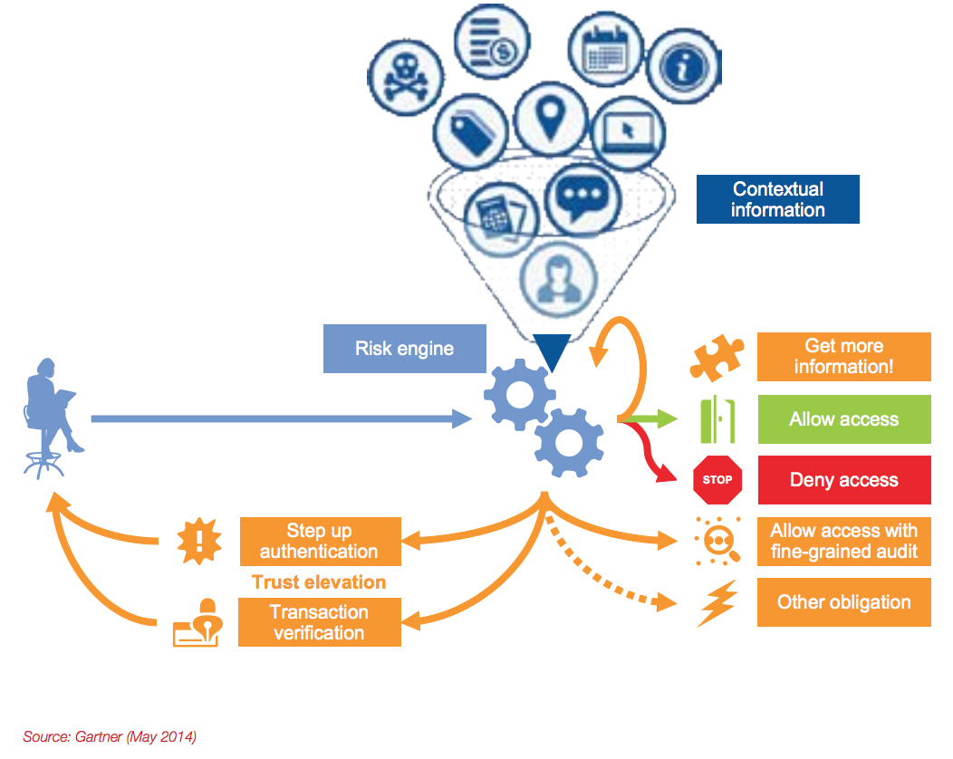
Some of the factors considered for generating the risk score
Login Device
Is this a registered or known device?
Is there an associated fingerprint that can verify the device?
Geolocation
Did the user login from a suspicious IP address
Geovelocity
You can’t sign-in in Goleta and New York within one minute
Number of attempts
Is this a brute force attack

Slide 6
Overview of how risk based authentication works
Service Provider
2
Fingerprint.js
5
5. Risk Score
3
1
Web Request
4
4. Form Submission
6
6. Allow
Mitigator
Client Browser
6
Web Server
6. Block
Source: http://sched.co/CuRl

Slide 7
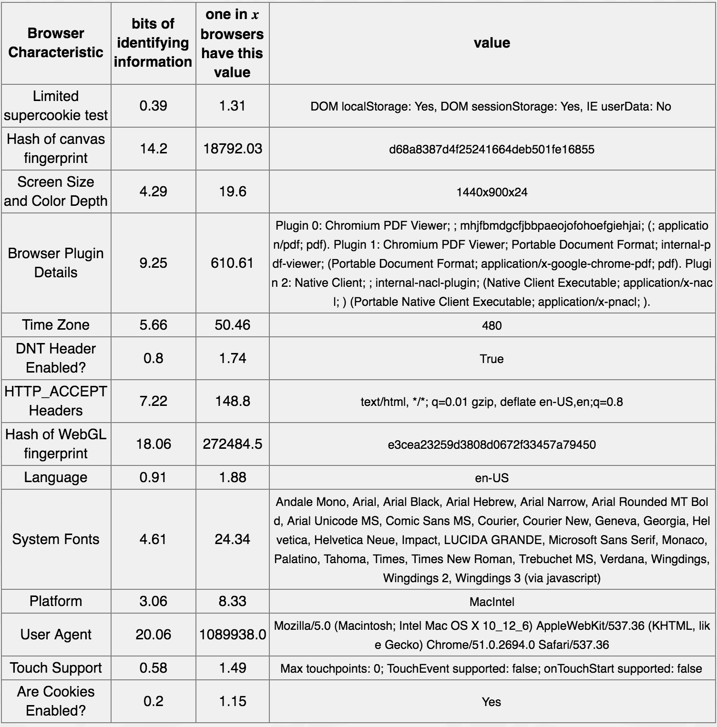
Browser Fingerprinting
Source: http://sched.co/CuRl

Slide 8
Introduction to castle.io
Website: https://castle.io
Security events
Basic user tracking
Webhooks
Automated recovery flow

Slide 9
Q/A

